Slide 1
Organize your writing craft using trello
Lauren C. Elkins
Twitter: @laurencelkins
#Trello4Writers
Notes:
Take a selfie with the room and post it on Twitter!

Slide 2

Bus ride to the left brain
Notes:
Who has read C. S. Lewis’s book, The Great Divorce? Summary…
Bus ride out of Grey Town takes souls to visit what could become heaven if they chose to stick around long enough. One of the stories teaches a lesson about when a ghost surrendered his earthly desire, he could become more beautiful, more powerful, and more loving than thought possible. Similarly, we don’t have to believe that because we’re creative people, we can only live in a right brain world. I’m going to be your tour guide into the left brain world and talk about organization. If you choose to stay around and surrender to a little bit of focus and organization, you’re writing can become more beautiful, more powerful, and more complete than you thought possible.

Slide 3
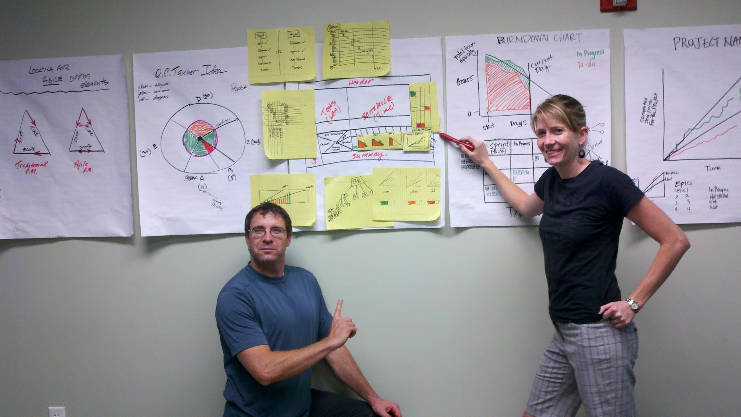
your tour guide
Notes:
I was once called a Certified Scrummaster, which is a software development project manager. It combines visual with project tracking. This is with my brother as we designed a dashboard for project statuses.

Slide 4
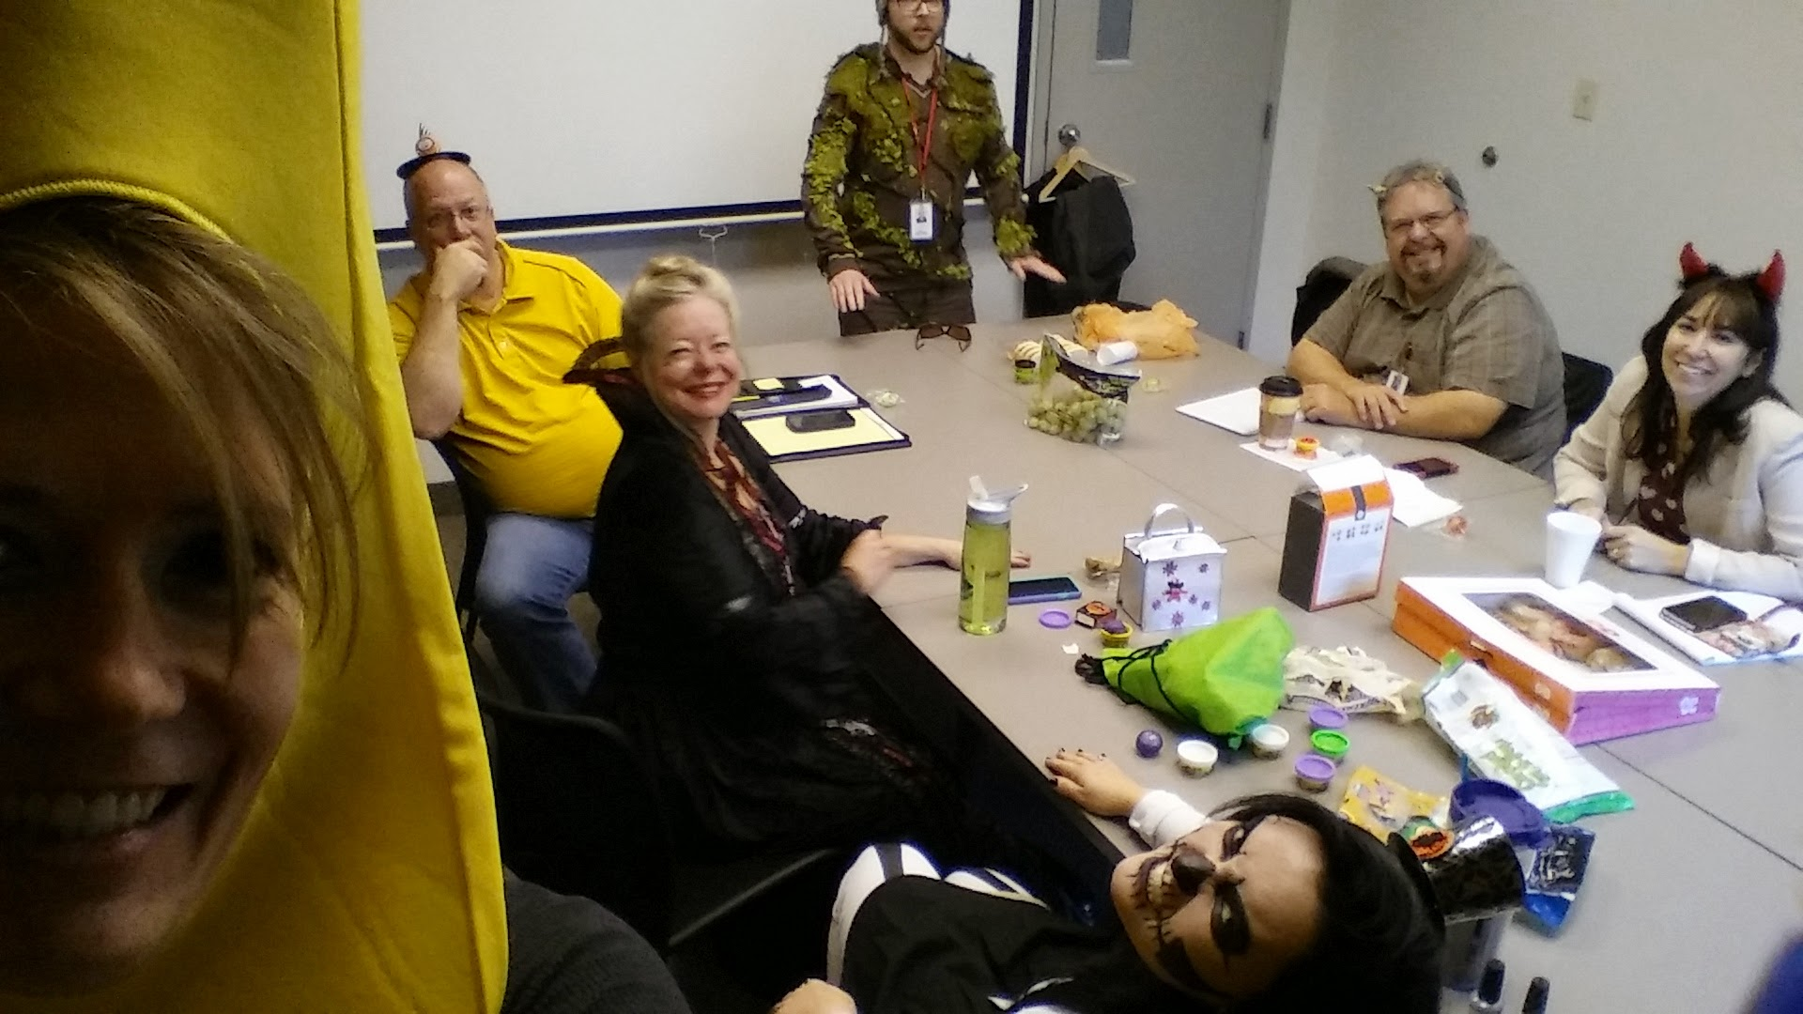
Notes:
I worked with software developers and testers. This was a Halloween meeting.

Slide 5
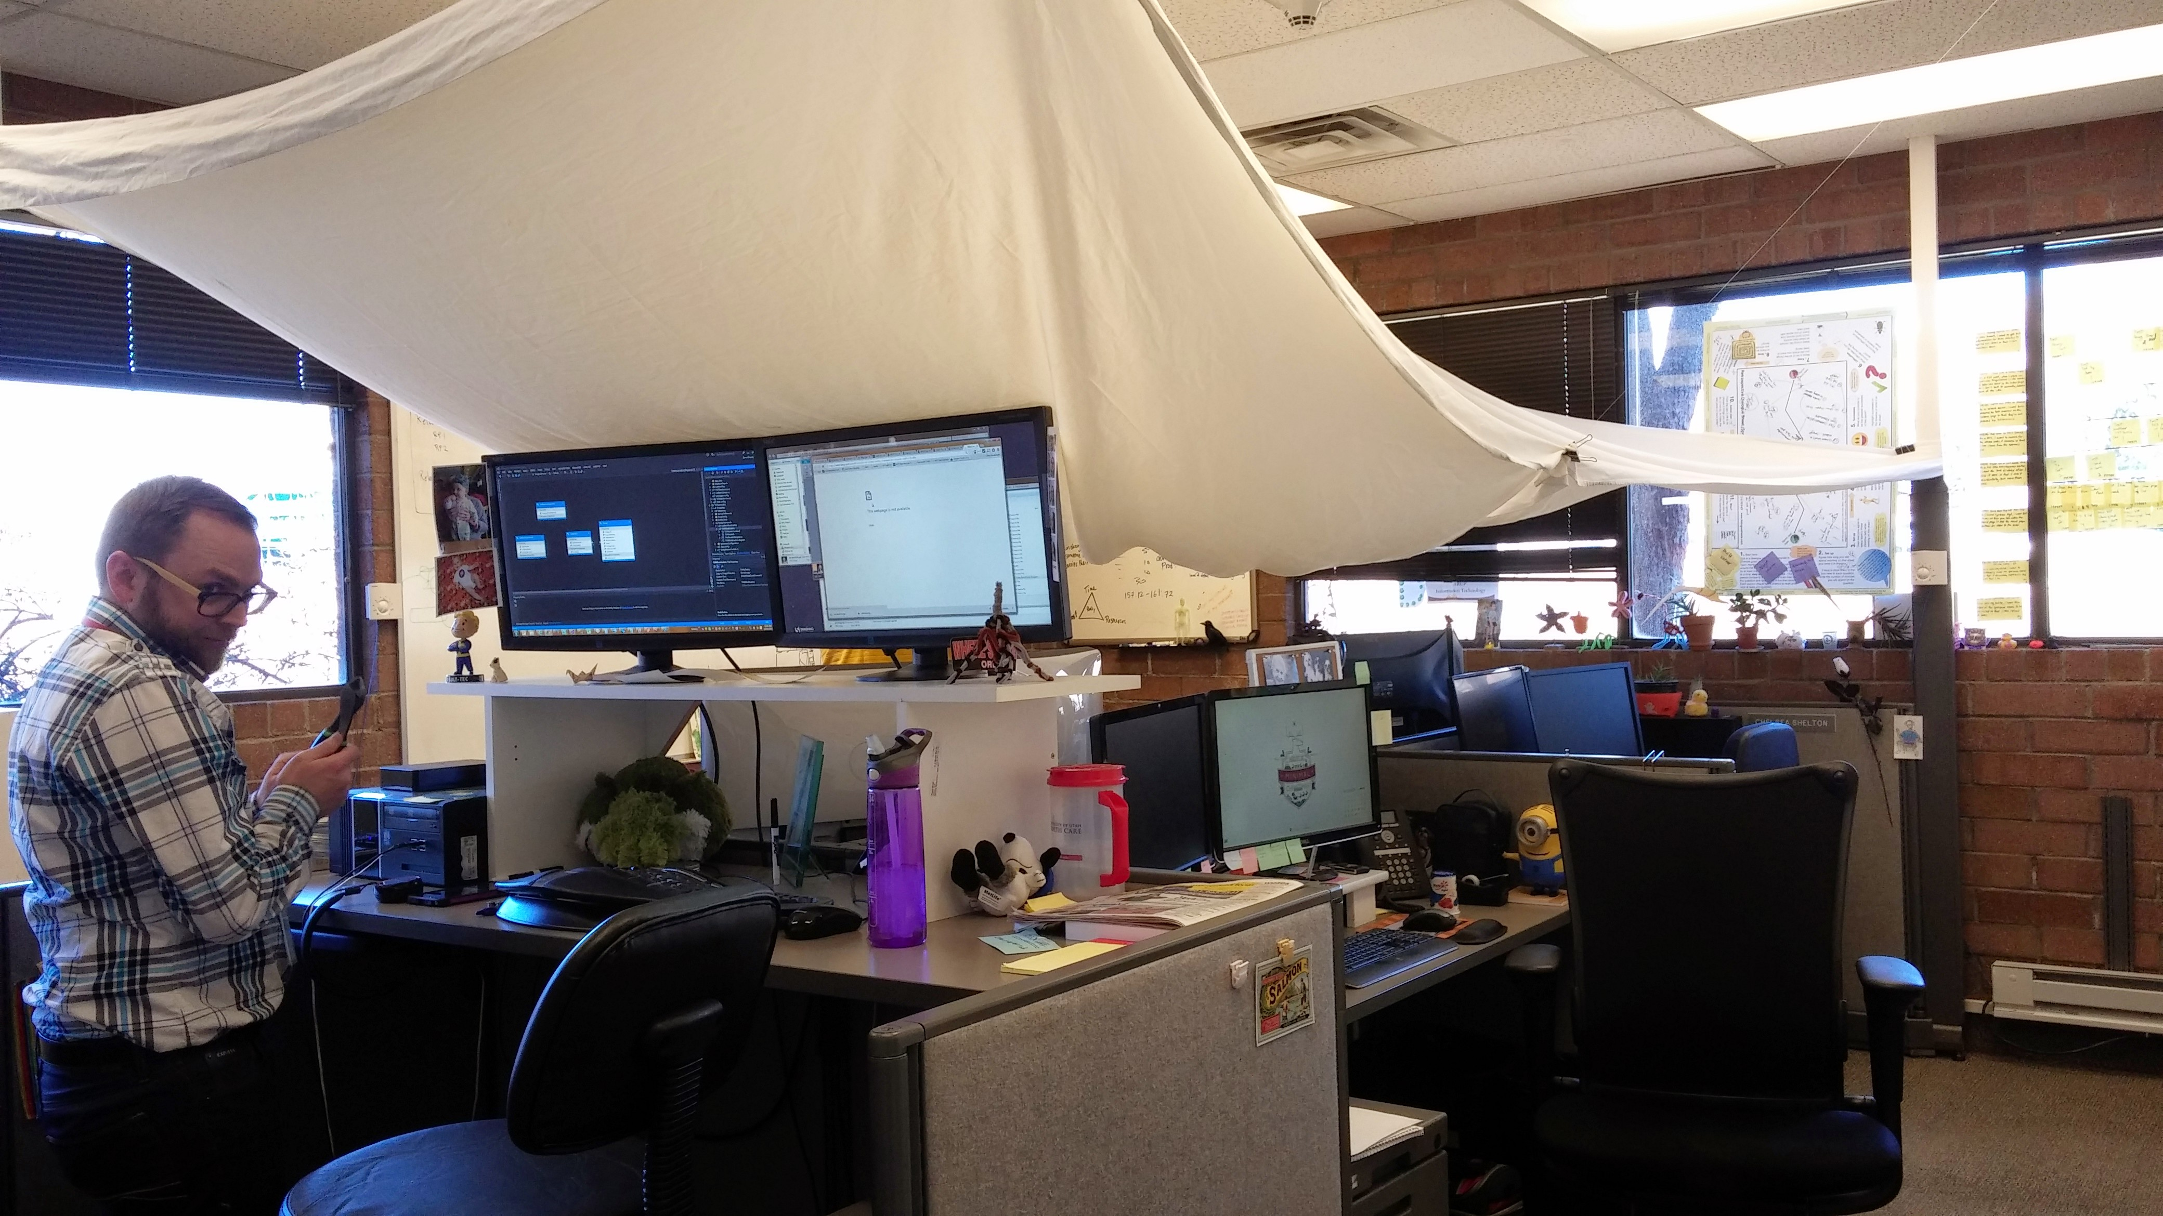
Notes:
Programmers are thought of a left brain folk, but we had plenty of right-brain activities like the day the network went down so we made a fort in our office.

Slide 6
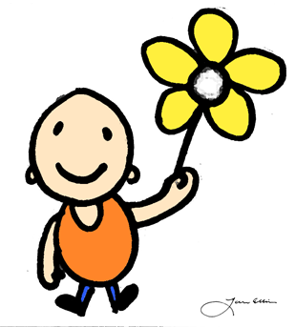
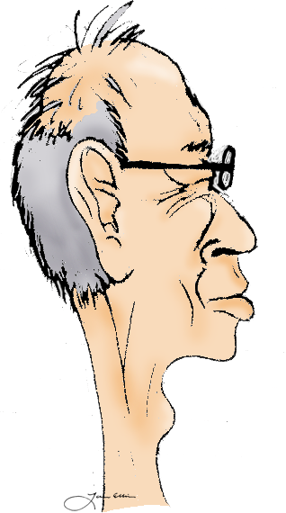
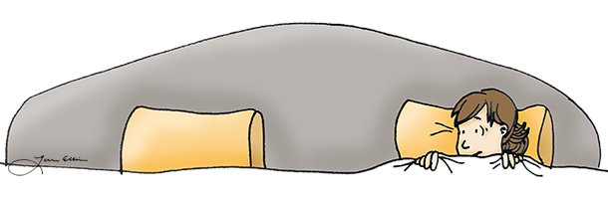
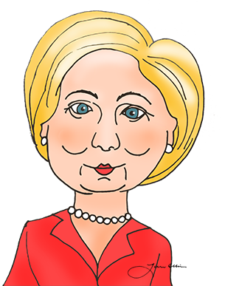
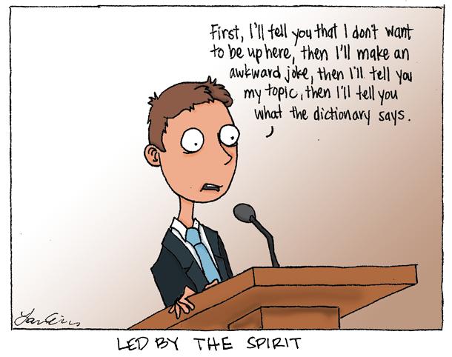


Notes:
I also like to doodle. That’s how I stayed awake in meetings. That’s my right brain coming through, right?

Slide 7
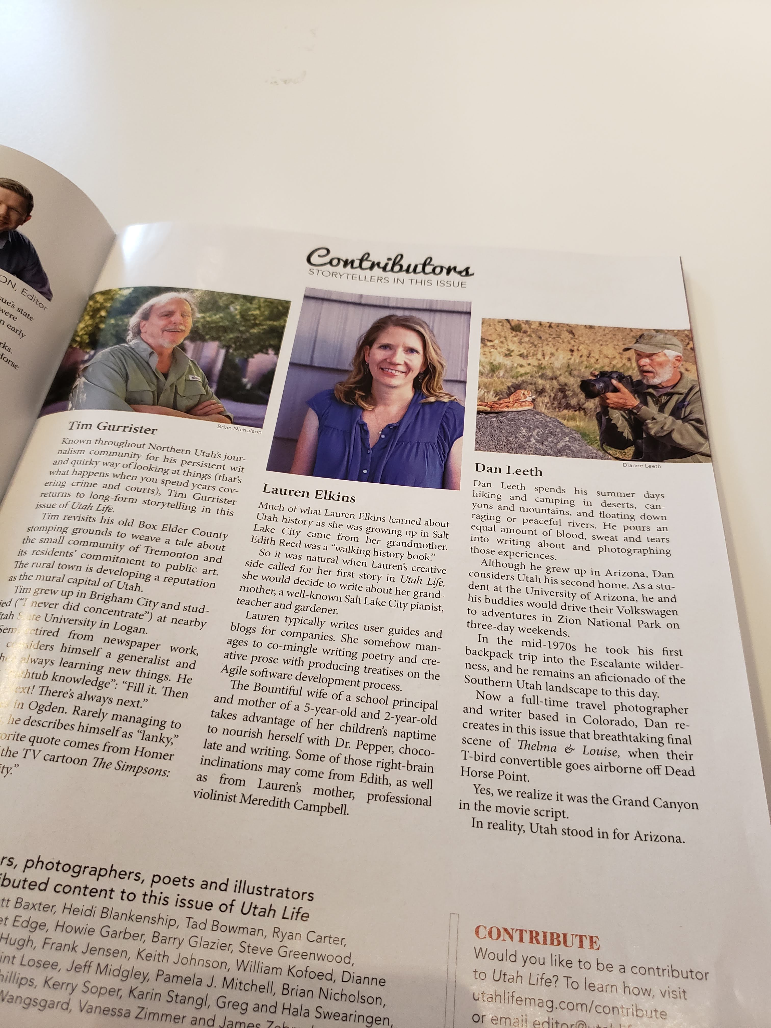

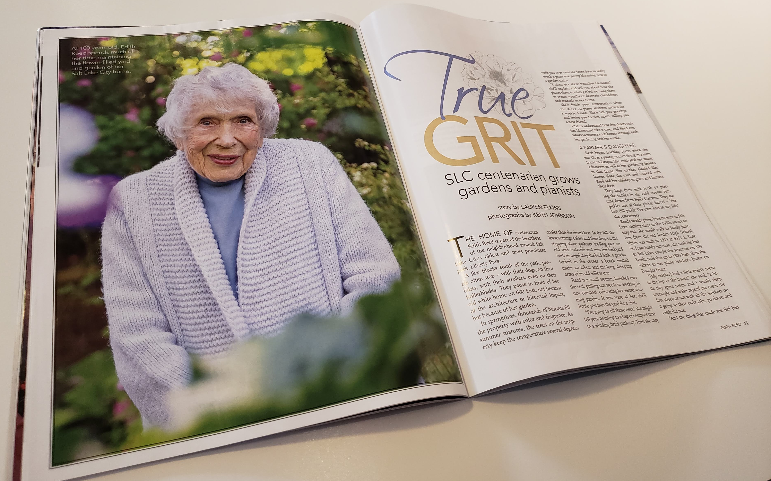

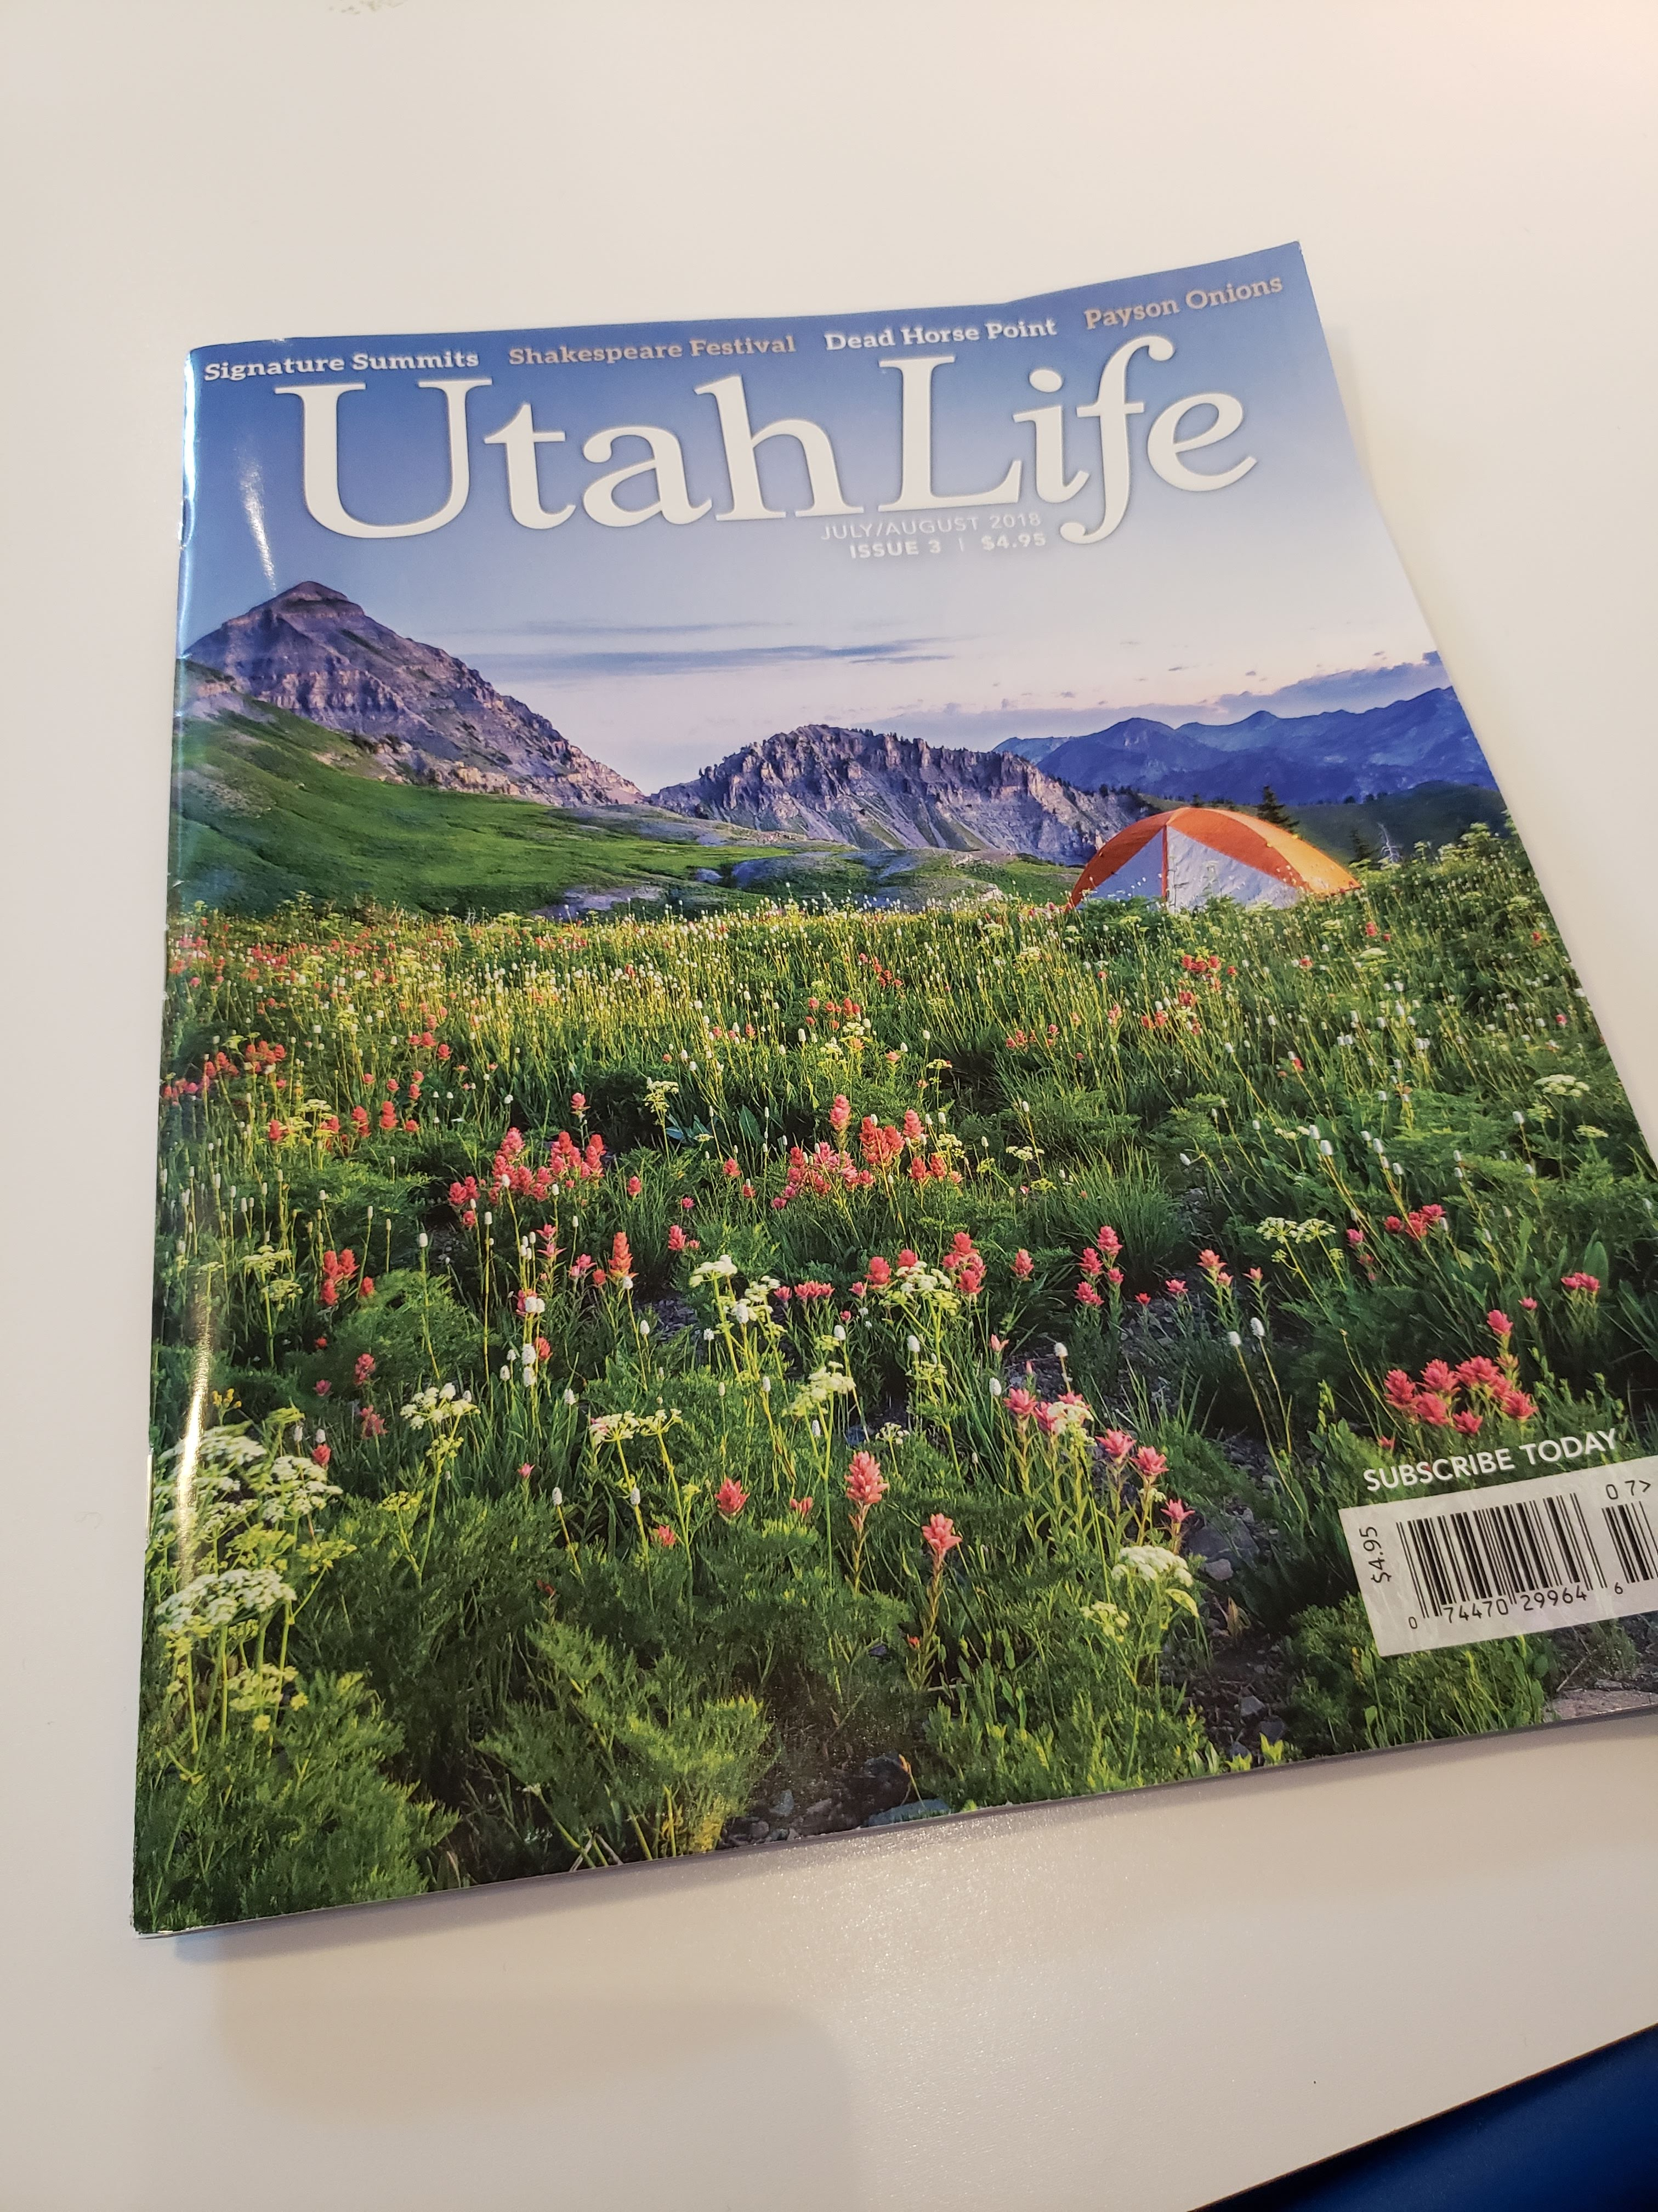


Notes:
For the past three years and change I have focused on writing, quitting my IT career. These are some of the places I’ve published and companies I’ve written content for. The freelance gig has been interesting, for sure.

Slide 8
Bus route
Where are we going to go?

Slide 9
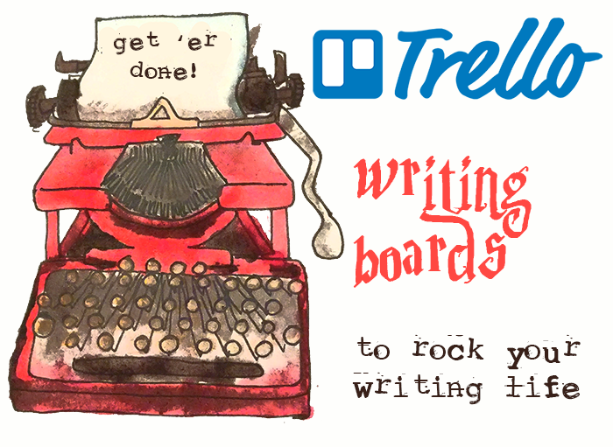
7 stops on our left brain ride
What is Trello?
Tracking Submissions
Brainstorming Board
Research Board
Editorial Calendar
Book Launch Planner
NaNoWriMo Board
Notes:
These are our 7 stops we’ll take today… [read stops].
For each of you, you’ll likely be more interested in one or another, but see if you can find a little nugget at each place.

Slide 10
First stop: what is trello?

Slide 11
Trello Board Basics
A visual way for tracking projects
Flexible and customizable
Collaborate with others
Make it as simple or complex as you like
Create columns, then begin adding cards
It’s FREE!!!!!!
Notes:
Trello is an online tool in the cloud. It’s really flexible and very basic as well. It’s based on agile software development principles because there’s a lot of success when you take your organization and status and make it visual. You can use it for yourself or invite another to collaborate with you.

Slide 12
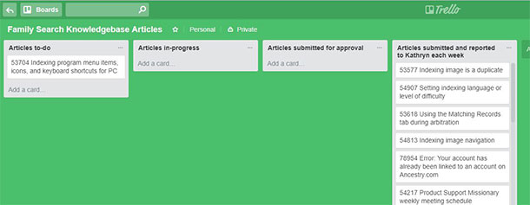
Trello Board Basics
The flexibility of columns and cards
Notes:
This example is from a freelance technical writing project I did for The Church of Jesus Christ of Latter-day Saints. I set this up for myself to keep track of each knowledgebase article I was editing. Put up Posterboard example #1

Slide 13
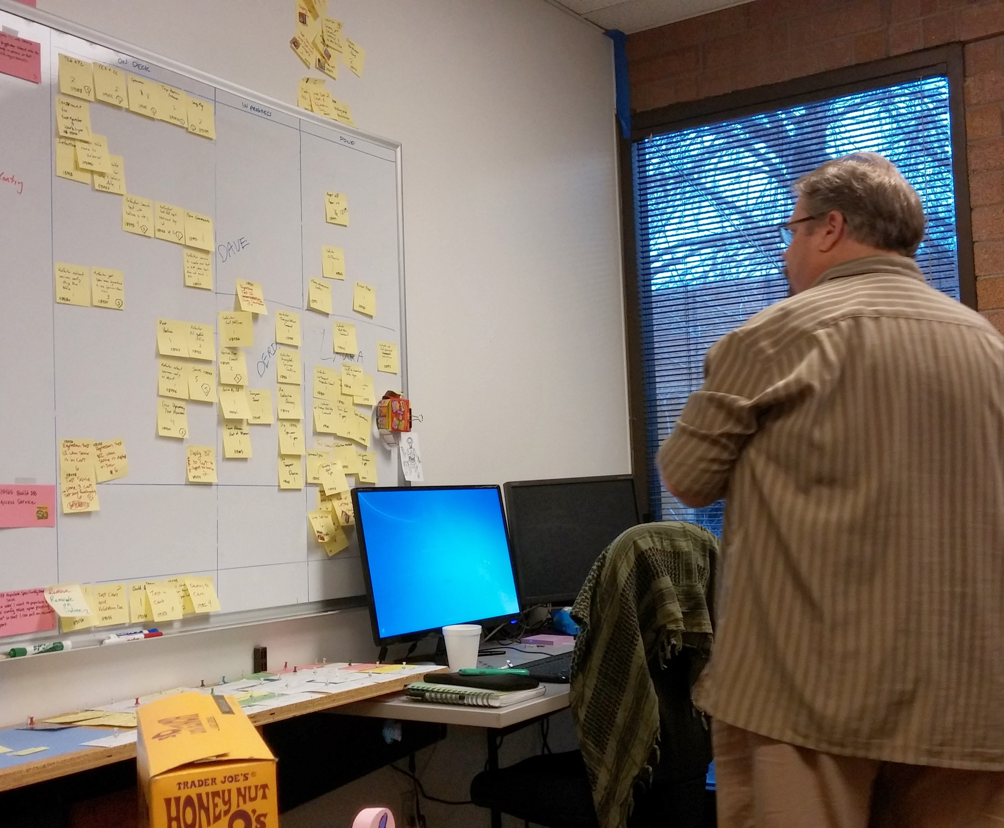
Trello Board Basics
Task board tool
Notes:
We used what’s called a Scrum board with our project teams. There were a lot of specific rules to follow for this board. We created a new one every two weeks. The pink cards are user stories, which represent a functionality in the software that the user WANTS. “As a user, I want to log in so that I can see my account information.” There were more specific rules for each user story card as well so the developers understood the expectations. Then, we created post-it notes to represent the work required to make it happen. “Create a log in screen.” “Connect to the database table with user credential information.” “Create page for incorrect login credentials.” Then, we had our columns: On Deck, In Progress, and Done. We focused on one card until all post-it notes were done, then the card was considered done and we could move to the next card. This kept us focused. For me, with my trello boards, one way I stay focused is by not allowing myself to have too many cards “in progress”. Otherwise, I’m starting a lot of things without actually finishing.

Slide 14
Next stop: tracking submissions
Notes:
Question: who here will get themselves hyped up about finding some new places to submit their work, dive in and find these great categories that they totally have stuff for, and then, a few weeks later, you’ve forgotten what they all were? I checked out the Writer’s Market from the library a couple of years ago. I scoured through the pages and was so motivated about it! But I didn’t keep track of all my great ideas and the places I was going to submit them.

Slide 15
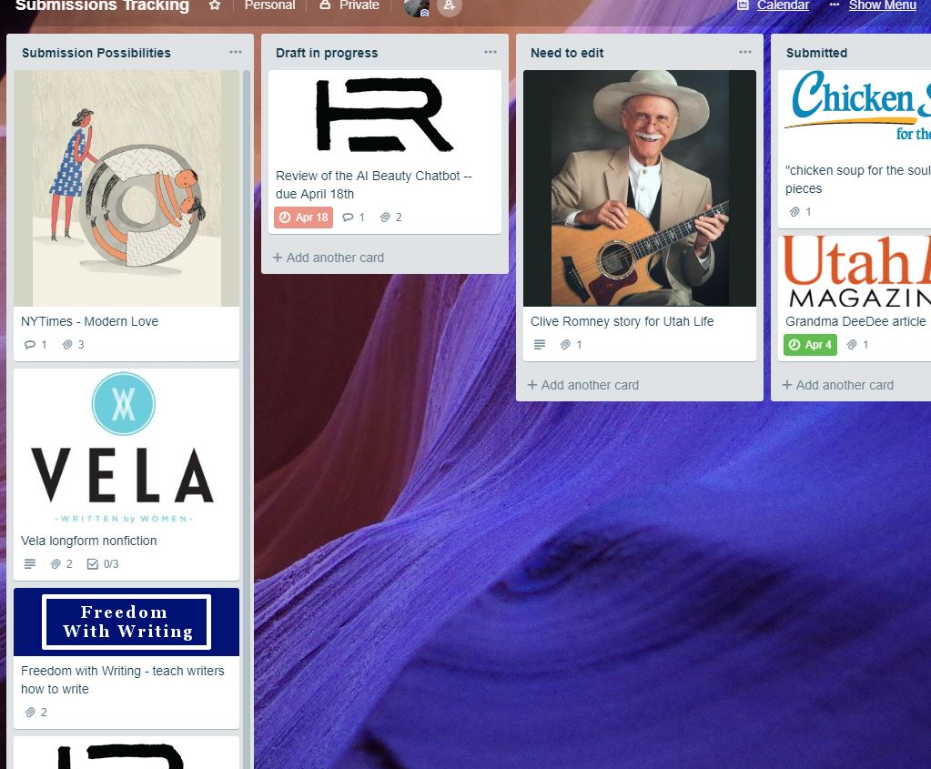
Tracking submissions
Use more than Submittable
Notes:
This is a useful board for writers who send it a lot of submissions to literary magazines, contests, and websites. You want to know: When is the deadline? Did I send it in? Have I heard back? Rejected? Accepted?

Slide 16
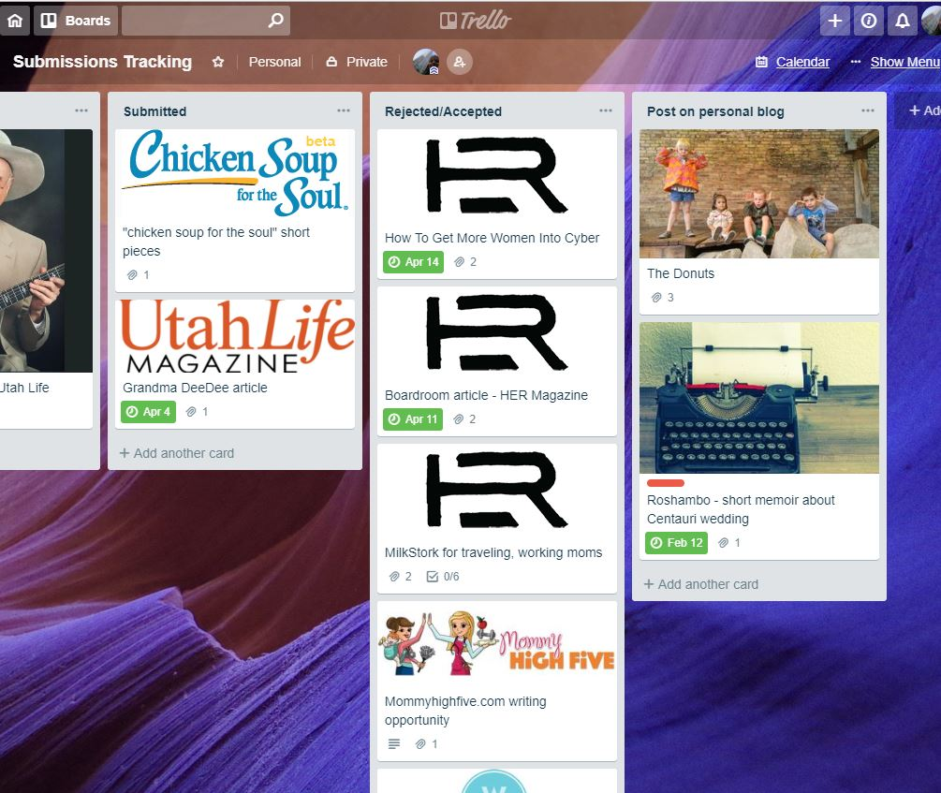
Tracking submissions
Columns:
submissions possibilities
draft in progress
need to edit
submitted
rejected/accepted
post on personal blog
Notes:
What do you do with your rejected work? Sometimes, I try to find a new place to submit it. Or, I post it on my personal blog. Do something with it!

Slide 17
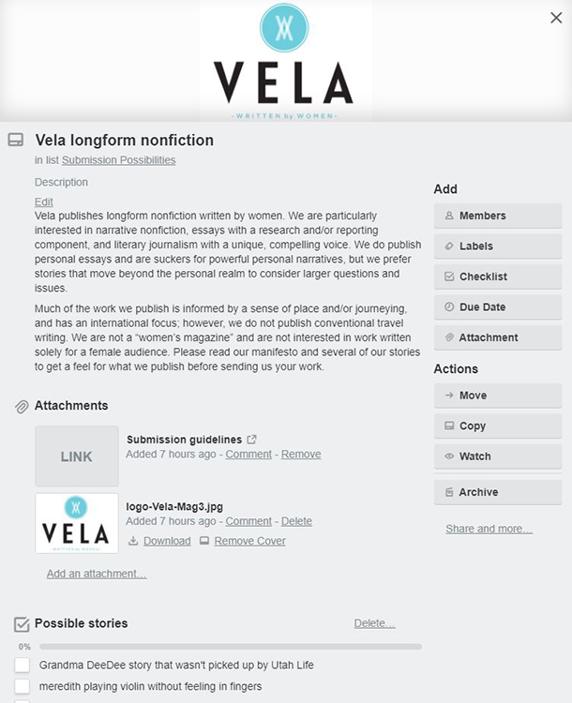
Details of a card
Description, link, story ideas
Notes:
Here’s an example of the information you can put on a card. I copy the description from their website of what they’re looking for. I copy in a link. I also attach the link to their site’s logo because then it shows up on my card and I’m visual. You can set the due date for when submissions must be submitted. I like to use the checklist feature for listing off what I might write about to submit.

Slide 18
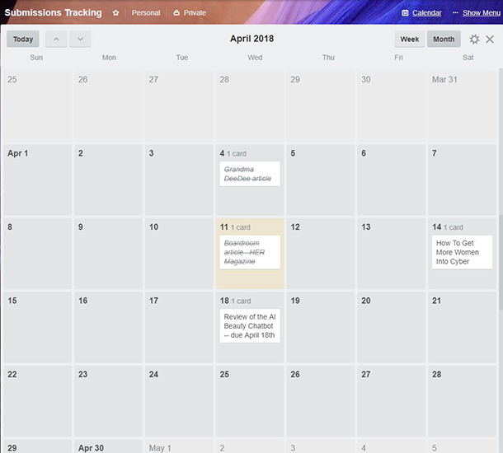
Keeping track of due dates
Switch to the calendar view to see what’s coming up on the calendar
Notes:
If you enter the due date in, you can click on a calendar link within Trello and it will display upcoming work.

Slide 19
Next stop: Brainstorming board

Slide 20
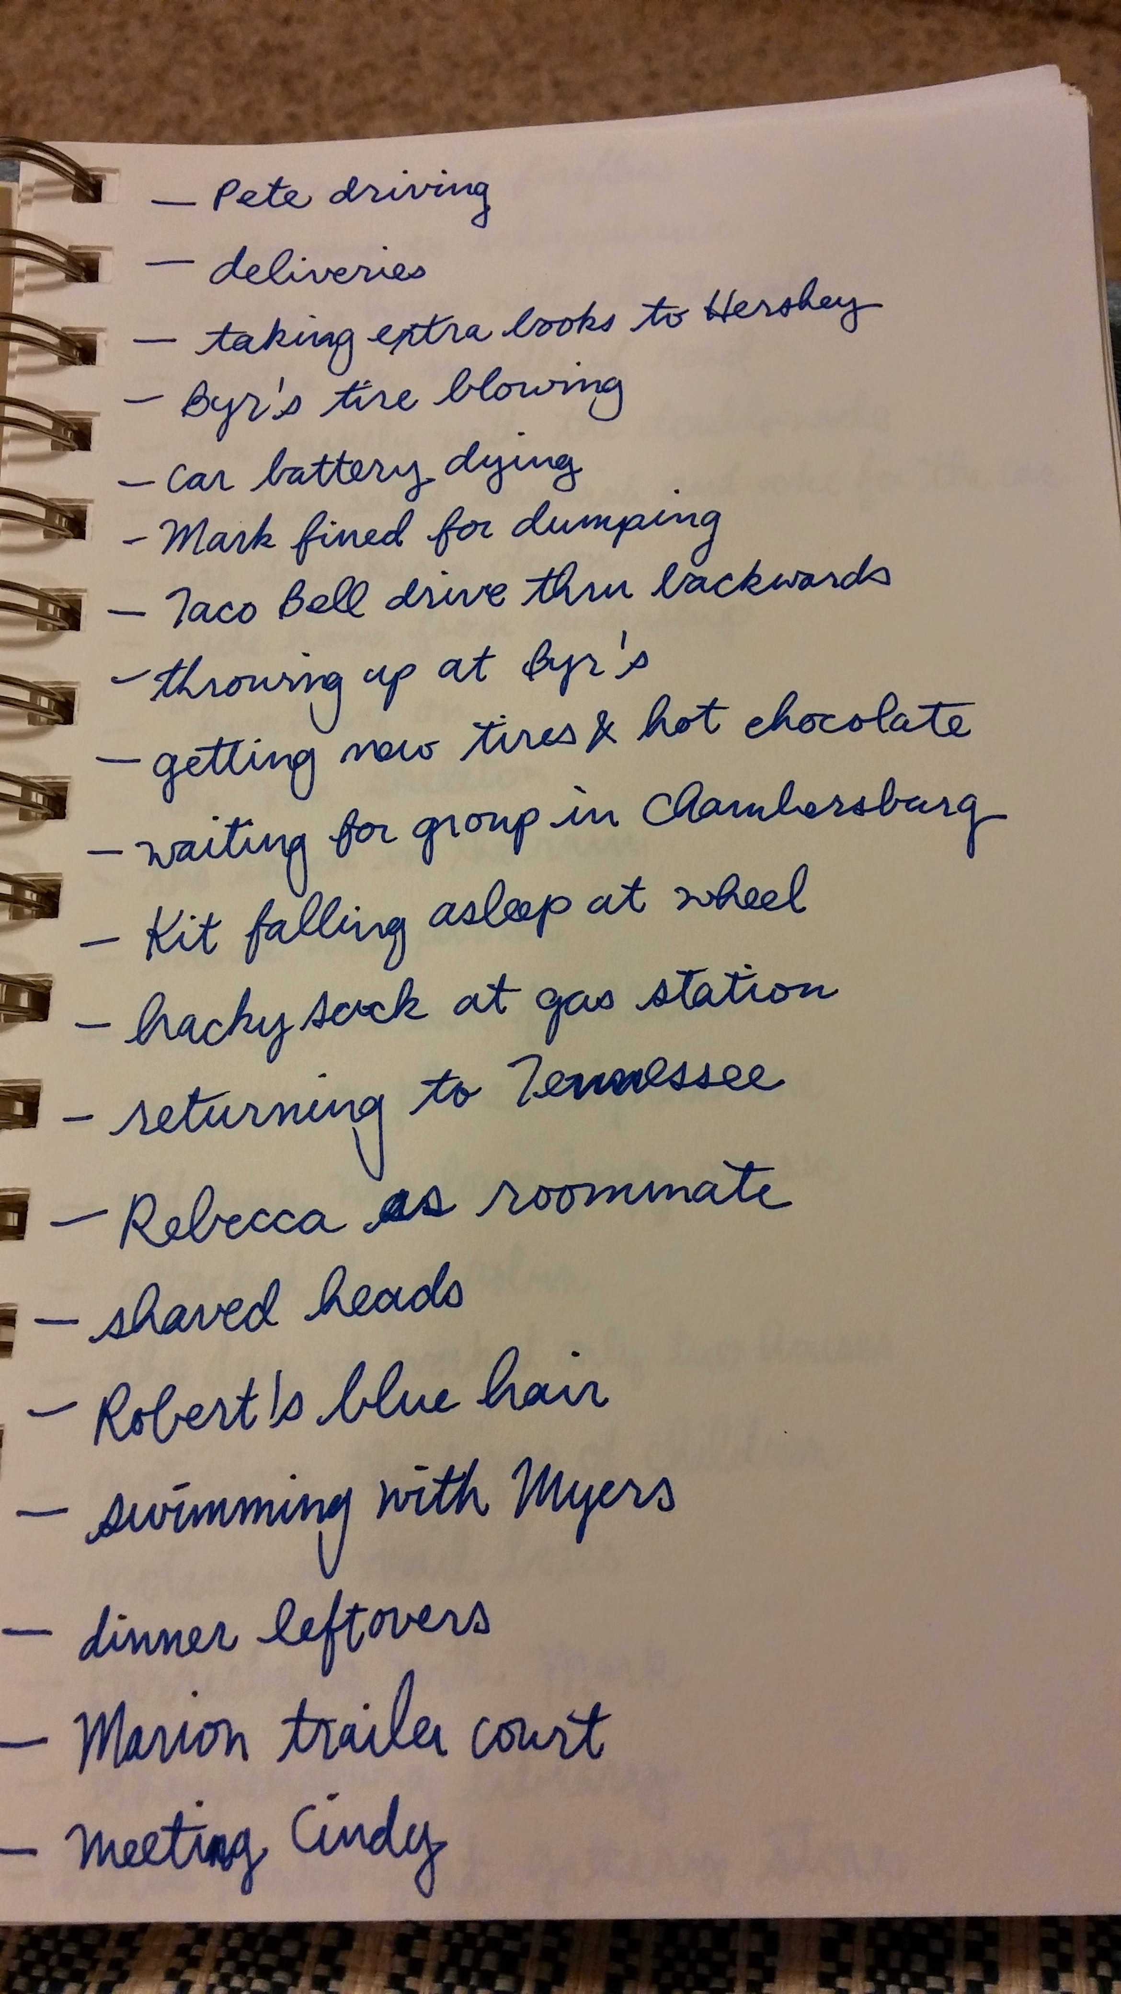
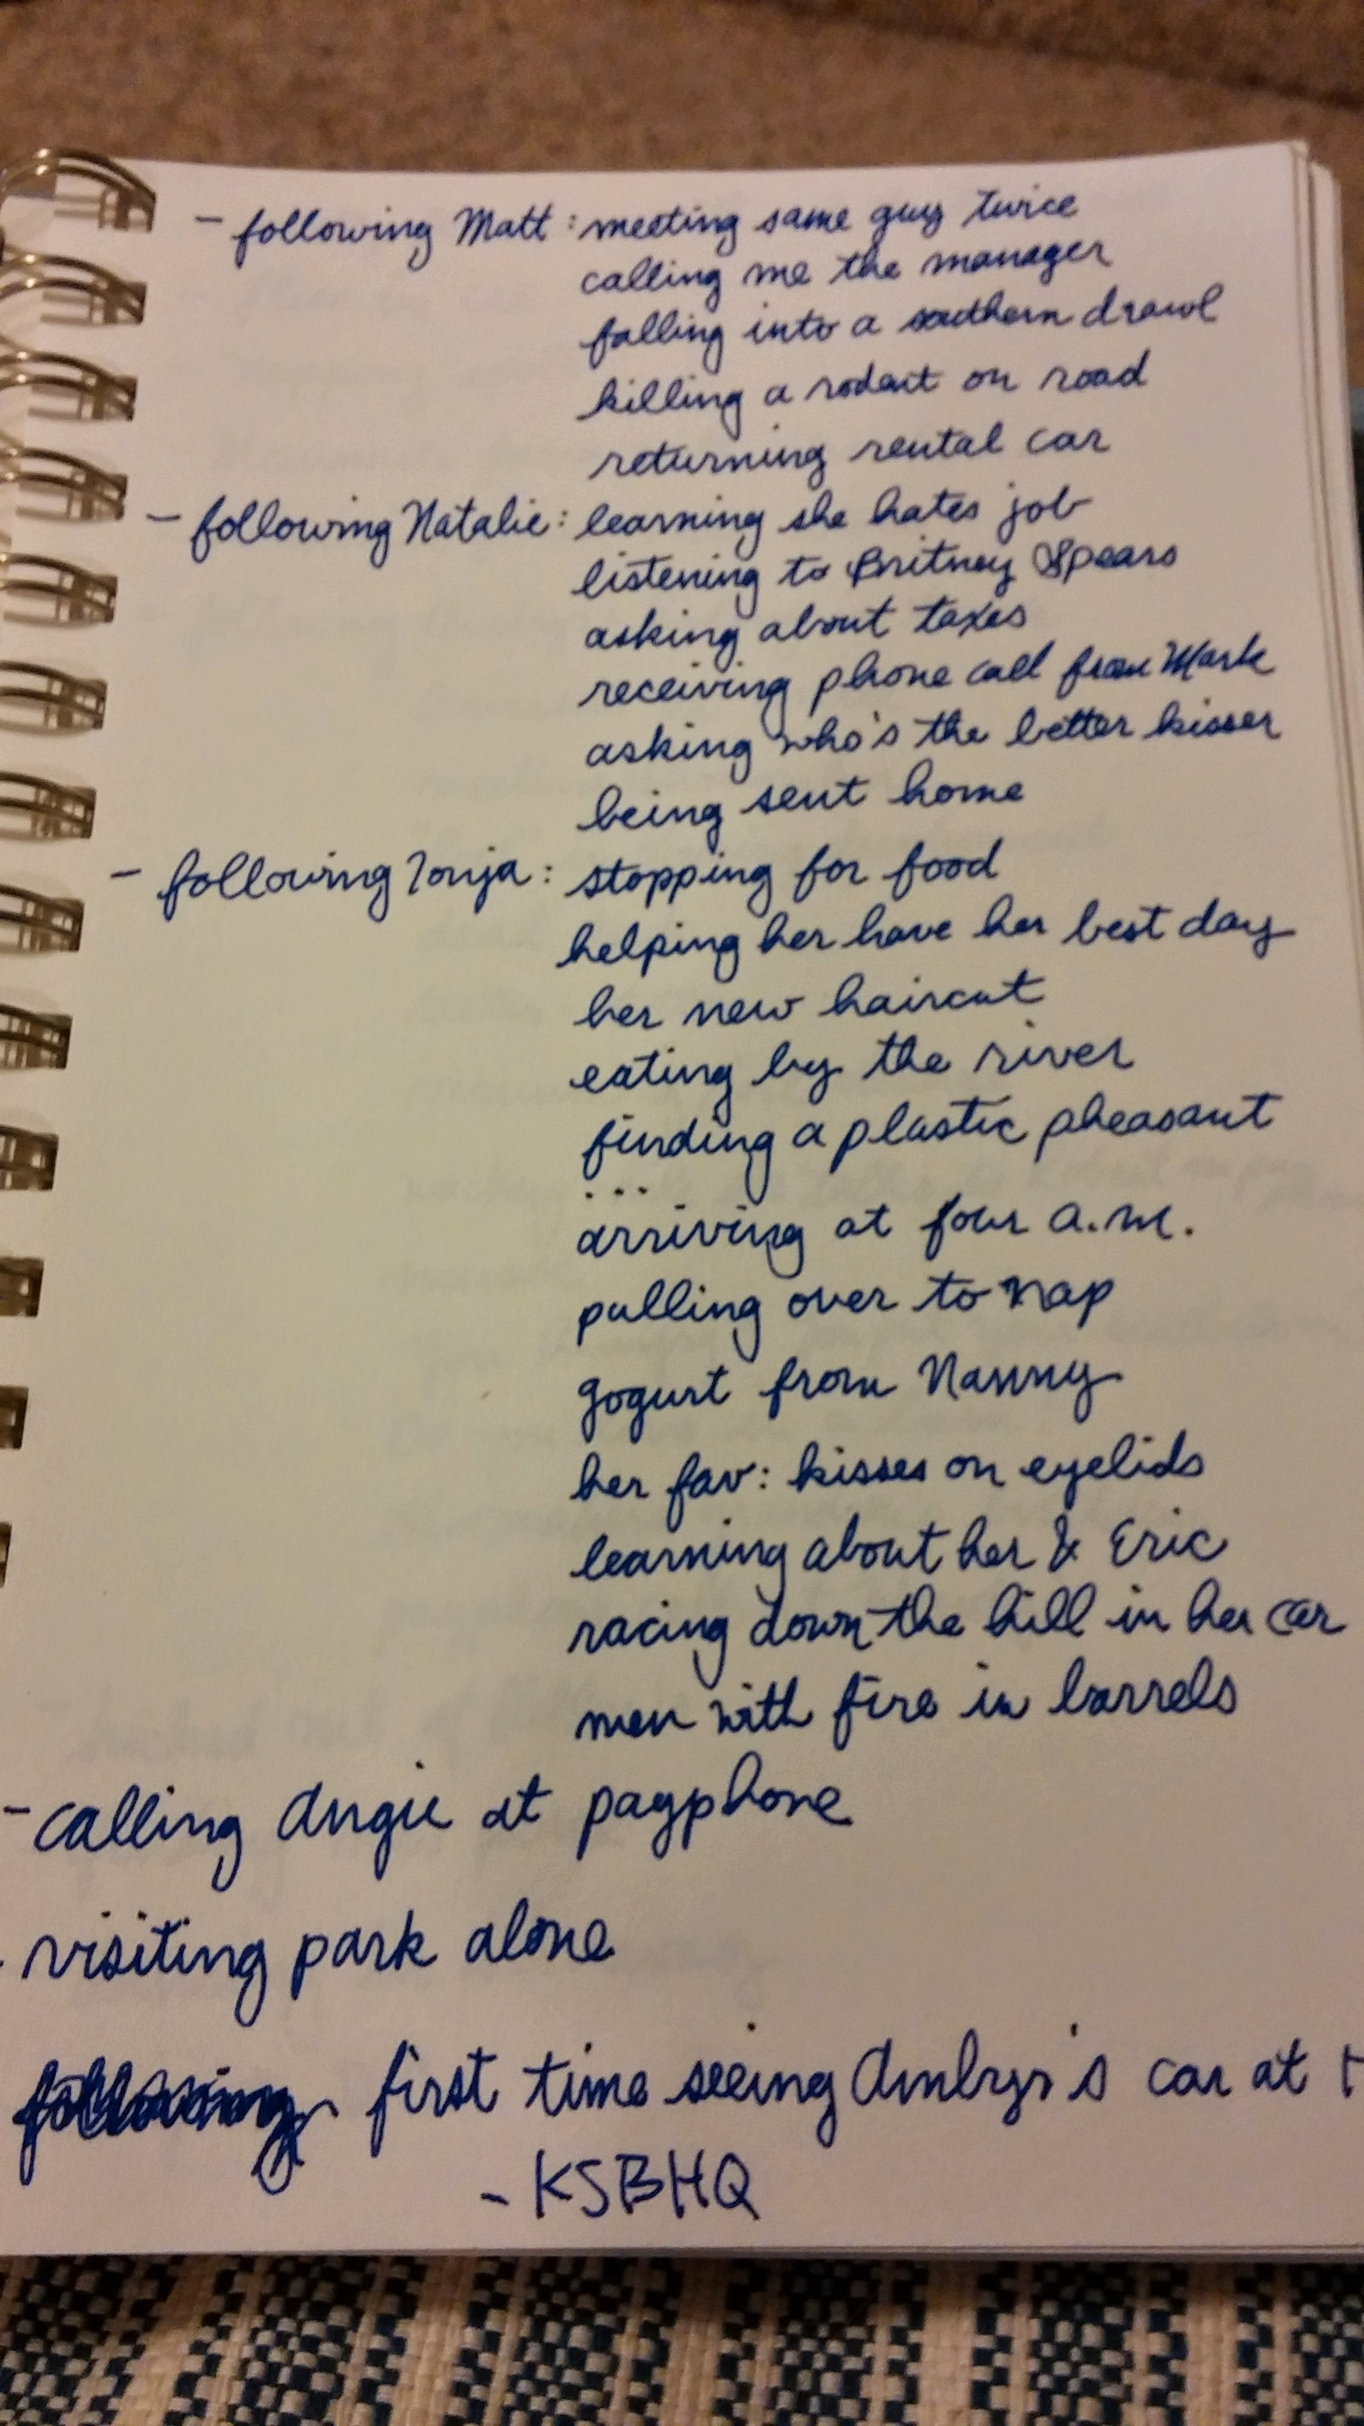
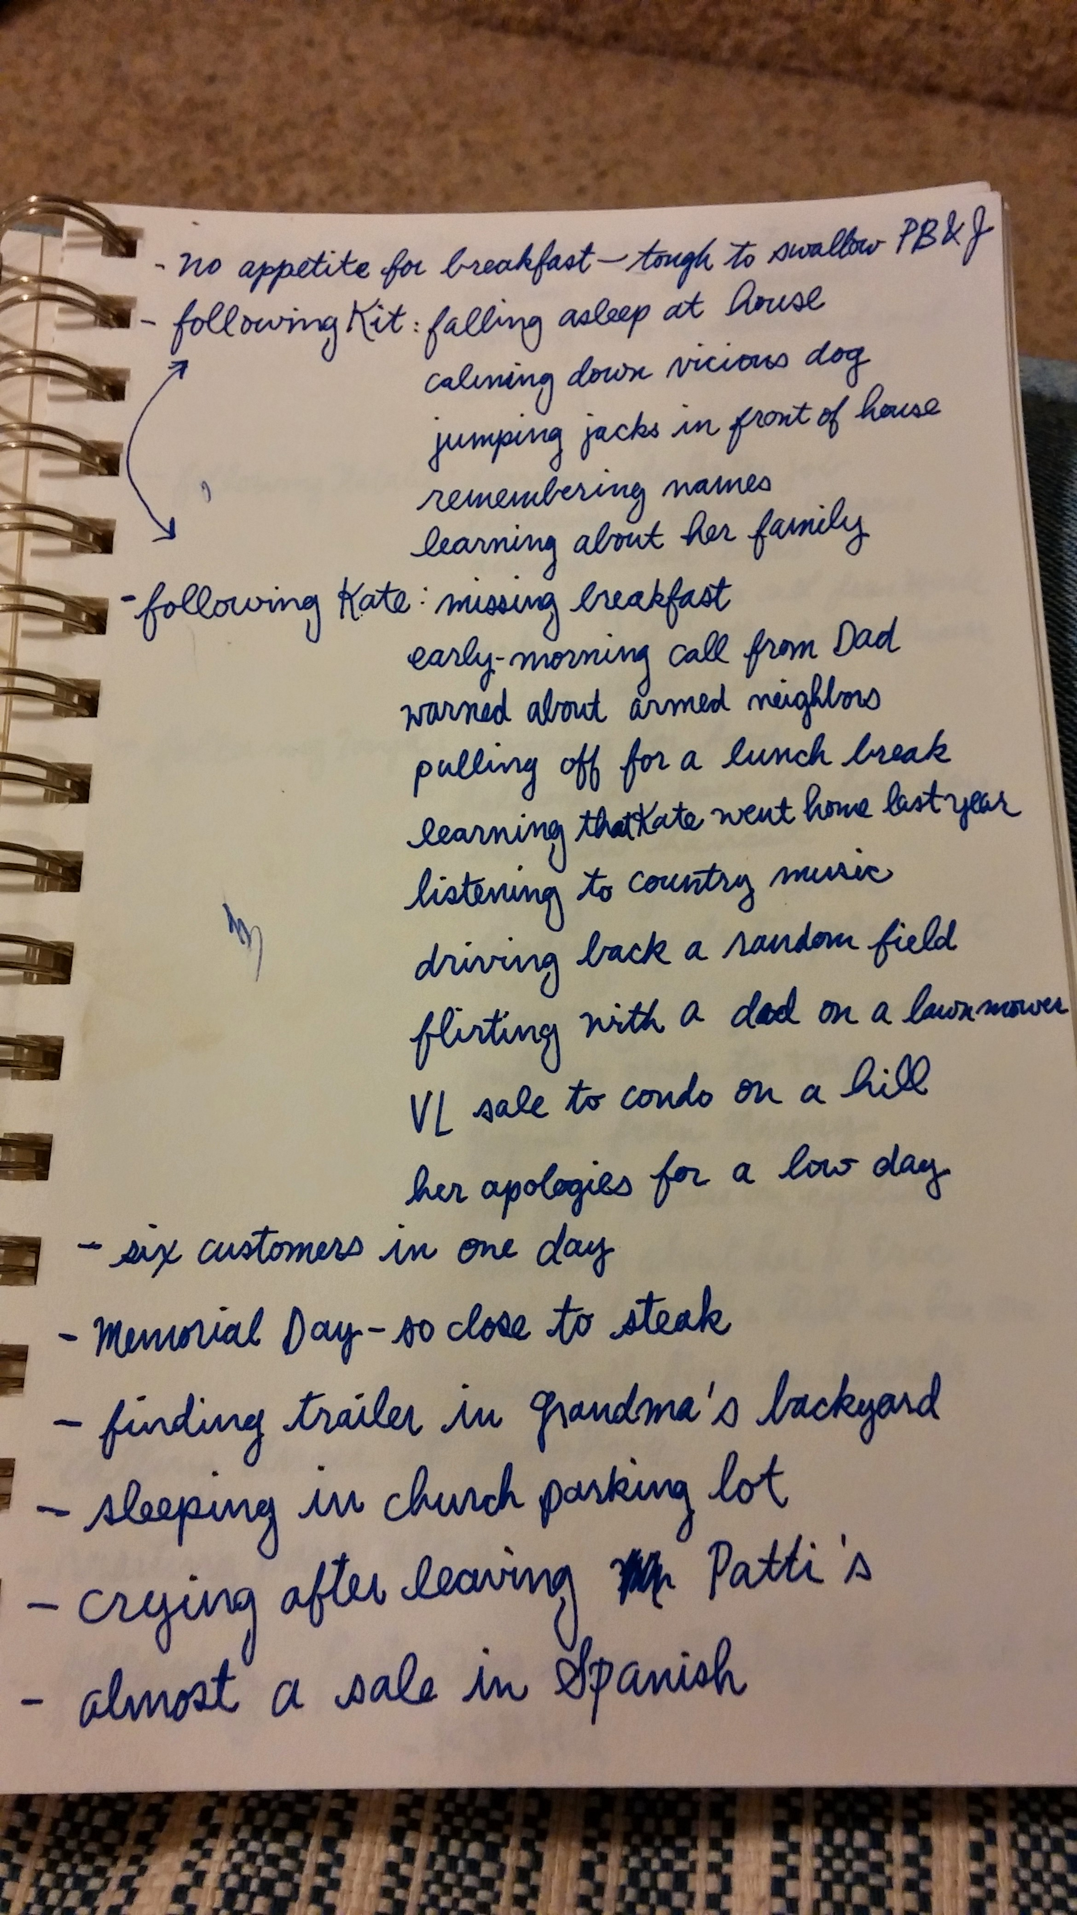
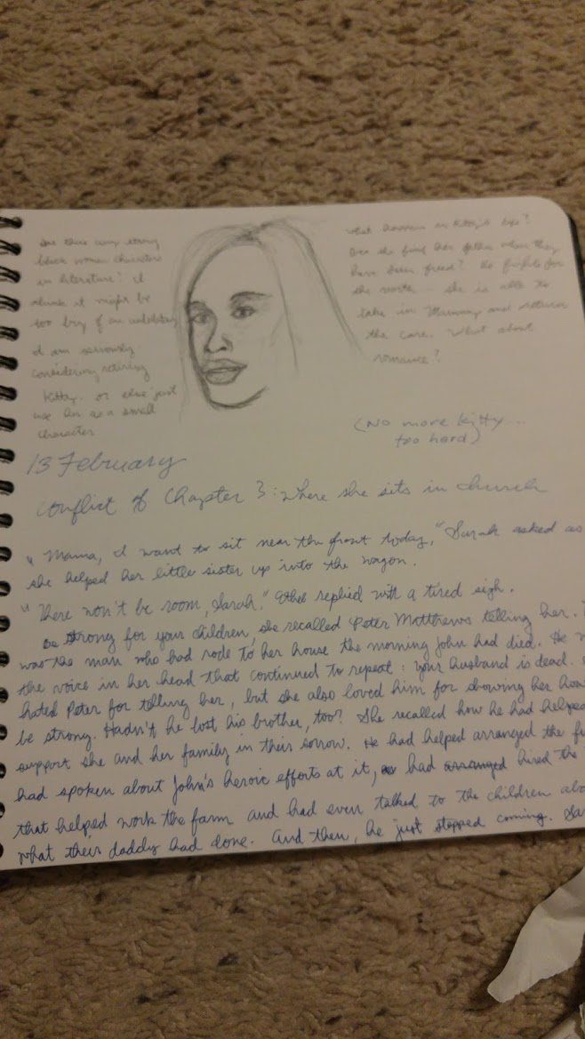
Notebook Brainstorming
Notes:
I’ve been slowly working away at a memoir for a number of years. I found this journal when we moved into our house four years ago and didn’t realize I had page after page of possible scenes or chapters scribbled in it. The last picture is of a Civil War historical fiction I researched for about a year and a half in college. I wrote about the first 50 pages and realized it was awful and scrapped it. The thing with notebooks for me is that they get lost. The memoir notebook has all sorts of other things in it and disappeared into the trunk of my old Volvo for several years. I think it was smashed underneath a folding table and golf clubs.

Slide 21
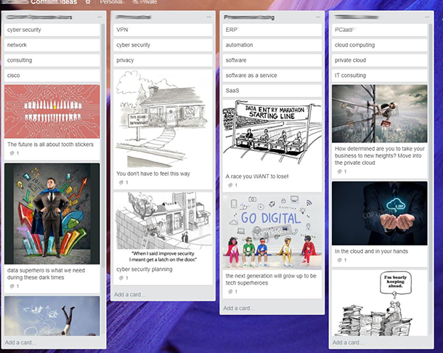
Know where to find your ideas
A brainstorming board on Trello keeps it all saved in one place
Notes:
One of my monthly projects is writing social media content for small businesses. Sometimes, I create posts by finding an article online to share. Sometimes, I create them by finding a good picture from the stock photo library. I have a column for each client in my brainstorming board. At the top, I have one card to represent keywords I should focus on, based on keyword research.

Slide 22
Next stop: research board

Slide 23
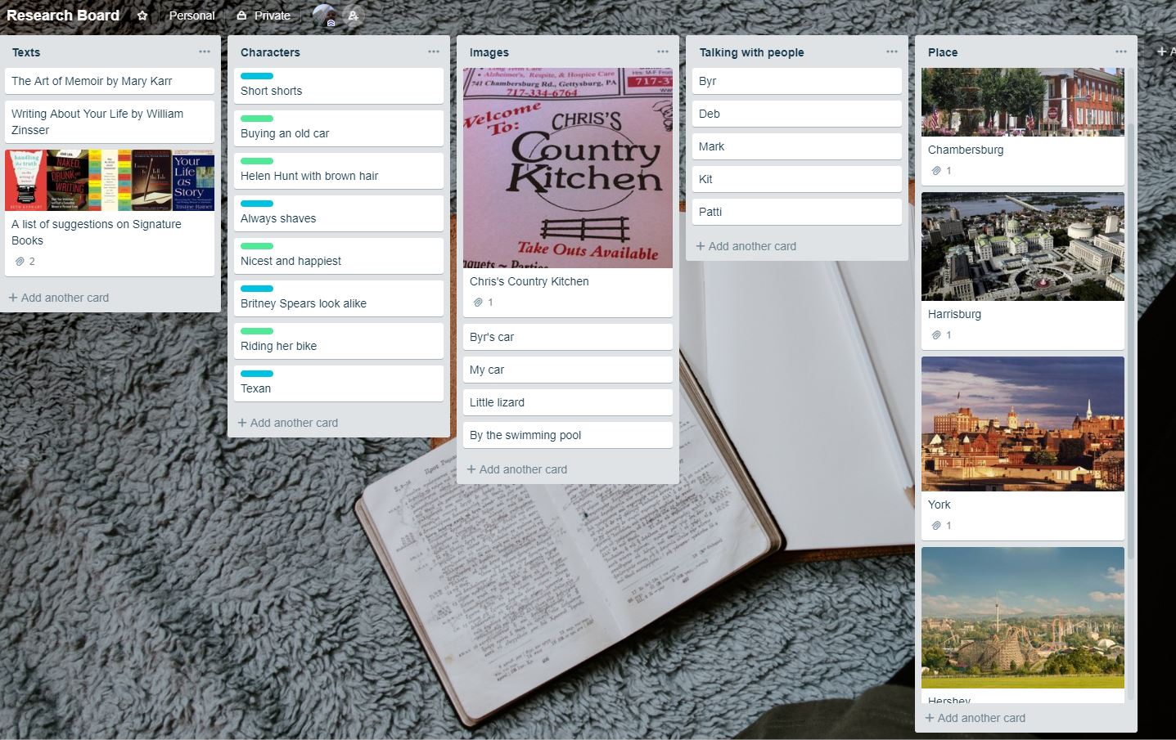
Research Board
Keep track of it all in one place
Re-structure and plan ad-hoc
Notes:
When you’re researching, you’re amassing a lot of information that you’ll likely need to find again as you get into the meat of your writing. Also, you’ll need to move things around as you develop a more concrete outline. That’s why I like the flexibility of Trello. For instance, you could start by researching characters and places and then begin moving cards into columns representing your story arc so you know when people get introduced or your characters arrive at a certain place in the story.

Slide 24
Next stop: editorial calendar

Slide 25
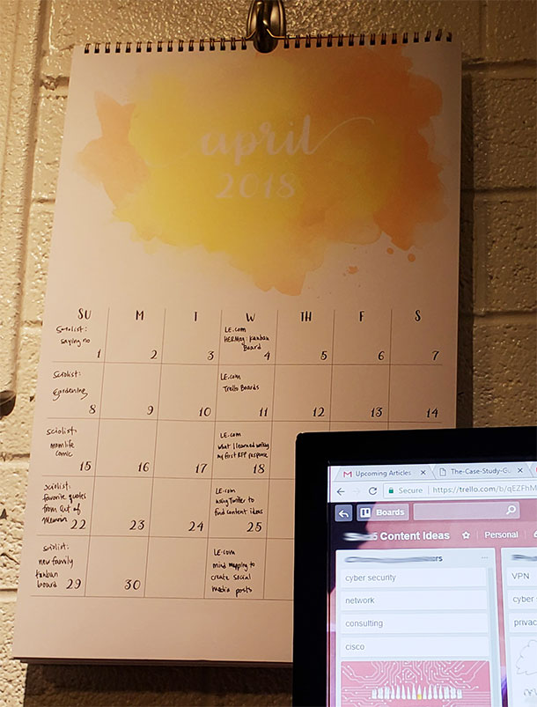
A calendar on the wall or in the cloud?
Wall calendar
Trello calendar
Hubspot
Mashable
ReadWrite
The Changelog
Notes:
Keeping track of which blog posts you want to publish and when. Is blogging dead?

Slide 26
Is blogging dead?
Attempts to kill it:
  Click-bait
  Social media
  Podcasts
  Vlogs
  And on
What still matters today:
  Sharing what makes you happy AND brings value to others’ lives (recipes, nutrition, DIY, self-care, business strategy, etc)
  Multimedia: images and video
  Connection: not right away, but with consistency
  Developing content matters, ESPECIALLY for writers
Notes:
We hate click-bait titles. We no longer blog like we did 5 years ago about what we did that weekend, but instead post it on Instagram or snapchat it.

Slide 27
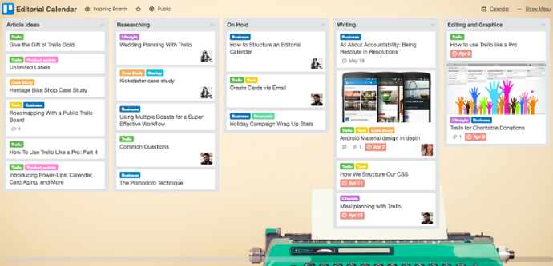
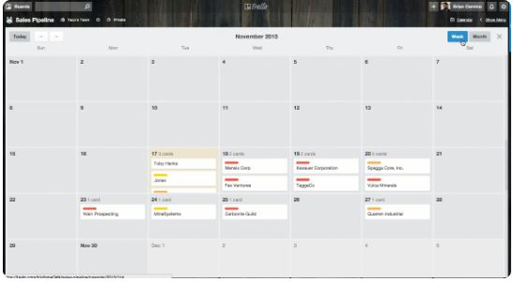
Hubspot’s editorial calendar
Create columns based on a single post’s progress:
Or: organize posts by categories
Connecting the team with Trello
Notes:
Sometimes, the greatest challenge isn’t creating content… it’s the OTHER related tasks: brainstorming, scheduling, keeping track of it all, even coordinating the moving parts

Slide 28
Next stop: book launch planner

Slide 29
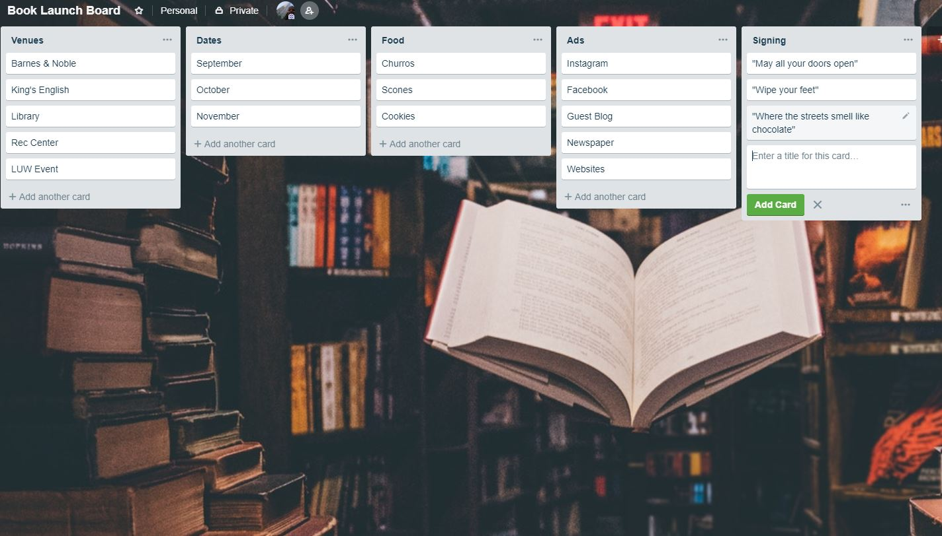
All the pieces for launching your book!
Come up with what you’re going to sign in your books before time. Imagine that!
Notes:
Venues: attach pictures, color code it with which ones you like most, put down contact information, location, parking, size, etc.
Dates: Keep track of your own personal dates such as vacation, then put in dates of events. When you switch to calendar, you’ll see them all.
Food: which venues can you provide food and what cool little business can you partner with?
Advertising can include the actual graphic design on the card, social media, media alerts, and on.
What are you going to sign inside your books? Some clever phrases that relate to your book are good to think up ahead of time.
Other columns might include a shopping list and people to send thank you cards to.

Slide 30
Next stop: nanowrimo board

Slide 31
NaNoWrimo Board
If you’ve drafted your story, work on the chapters or chunks, one at a time.
If you’re simply shooting for a word number goal, create cards to represent hitting milestones such as 1,667 words each
If your goal is to put in a certain amount of time each day, create your cards for each of those: 25 minutes each day.
Create a Trello board for a local NaNo group. You can put yourself on your cards with a picture and comment on each other as you hit certain word count milestones.
Break down a large project into individual pieces

Slide 32
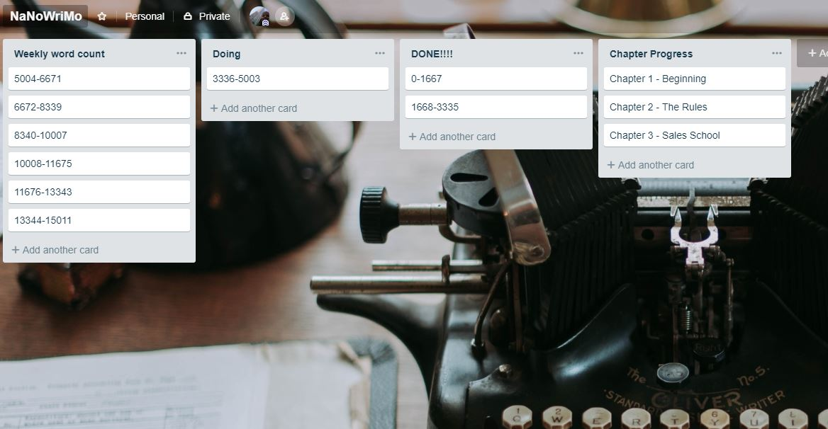
Word count board
Add chapters as cards you create/write them
Notes:
To hit the 50k word count, you need to write 1,667 a DAY in November. Can you do it? You could even add due dates to each card so you can see which ones are “late” if you start to fall behind. Then, you’ll have to disappear for the weekend and play catchup. What’s your favorite drink to sip on while you write? I’m a fan of Dr. Pepper Ten with Coconut Creamer mixed in

Slide 33
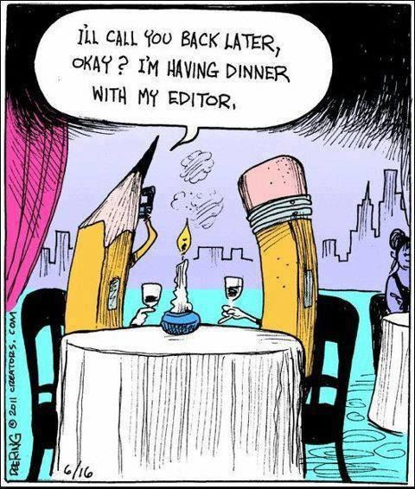
Lauren elkins
www.laurenelkins.com
Twitter: @laurencelkins
laurenelkins@outlook.com

